Slide 1
Smart Irrigation with Analytics Using SAP HCP, IoT and Watson
Emp Name: Chandra Prakash Meher
SAP MDG Technical Consultant
Sap Idea no:SAPIDEAS-I-485
Employee Id: 000HS6

Slide 2
Agenda:
Introduction
Problem Statement
Solution Architecture
Solution Approach
Technology Platform
Development
Q & A

Slide 3
Problem Statement:
In India most of the coastal lands are utilized for farming. So irrigating the lands properly is an important factor for better yield of the crop. With the increasing technology the agriculture sector should also be developed in order to meet the increasing demand.
With the advancement of wireless sensor network, cloud computing and Analytics this idea is about maintaining optimum amount of water needed by the crop to avoid excess run-off of water.
So, we can save a lot of water as the Smart irrigation with prediction will play an important role in deciding the amount of water required at certain time taking the climatic conditions into consideration

Slide 4
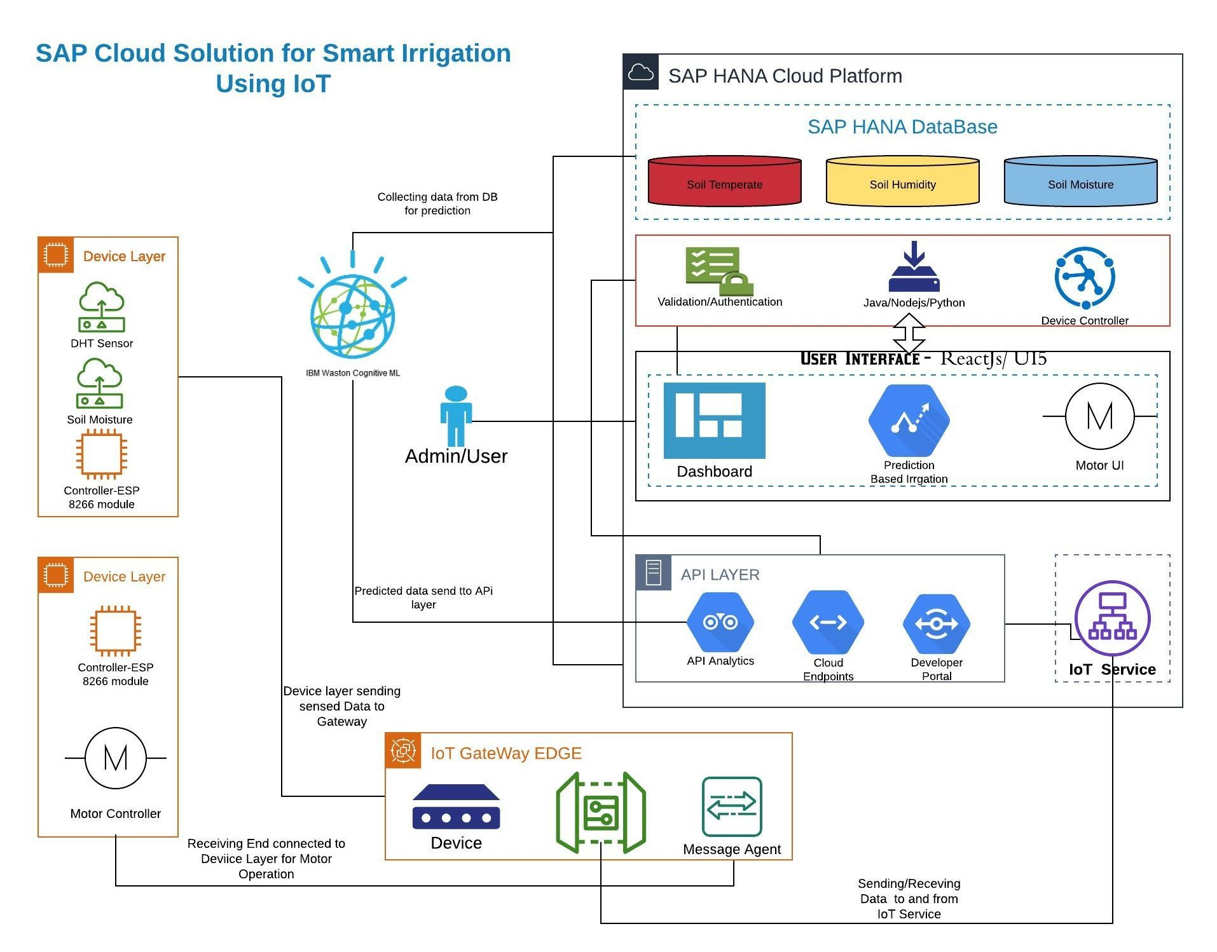
SAP HCP Solution Architecture:

Slide 5
Solution Approach:
To approach this , I would like to divide whole system in to phases / layers.
Like Device layer, Analytics layer, Gateway layers, etc.
So Understanding the layers would make the task easier to approach this development.

Slide 6
Technology Platform
The tech stacks that would be used in this idea are:
IoT(Internet of Things)
SAP Hana Cloud Platform
React JS(JavaScript library) / UI5
Typescript/Node Js/Spring Boot
IBM Watson(Cognitive learning for ML prediction)
Python for Developing script

Slide 7
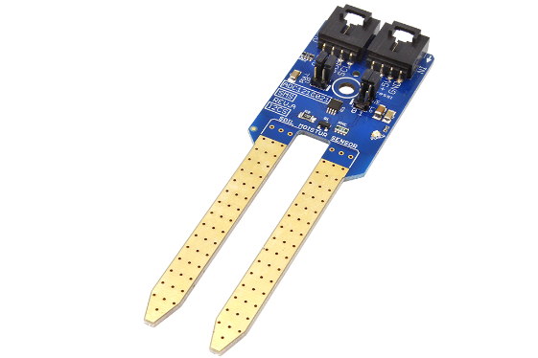
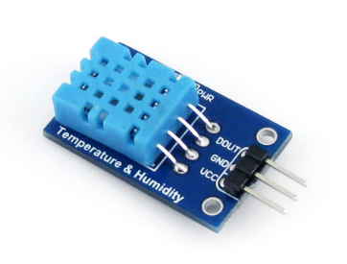
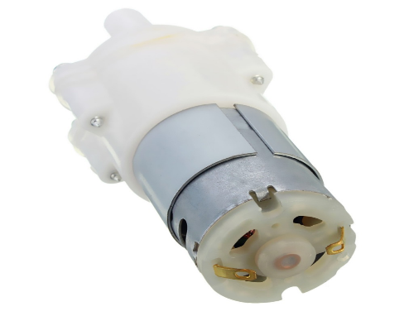
Development:
IOT DEVICE LAYER:
As a part of sensing the atmospheric data various sensors are used to collect various information required for decision support system.
Soil Moisture
DHT(Digital Humid and Temp. Sensor)
Water Pump

Slide 8
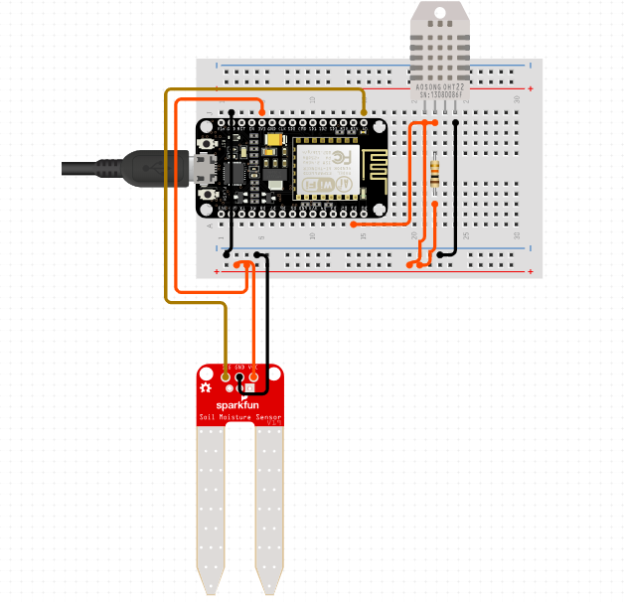
Gateway and API Layer
Development(Cont.):
This layer serves as the middleware connectivity between IoT Device Layer and Api Layer
API Layers connect to IoT Service, Business layer.
Data that is send to the cloud passes through API Layer and the Gateway layer which gets preprocessed before being sent to the cloud.

Slide 9
Development(Cont.):
Analytics Layer:
Use of IBM Watson Cognitive ML would result in boon.
Data from Hana Database would be fetched through API Layer
Using ML Platform of Watson , Data would be trained on the basis of requirement.
Once the model get trained with optimized and more accuracy then model would be send back to API Layer.
From business logic function may trigger to fetch the api to predict the Irrigation.

Slide 10
Development(Cont.):
Business (Logic) Layer:
Basically this layer play the important role and it connects all the other layers to UI layer.
It triggers functions to call API and perform respective task
Business layer would help in authorizing and authenticating the users , fetching API to get real time data from DB, Controller motor command and send back message to Device layer for action.

Slide 11
Data Model:
User1
UserName
Pass(encrpt)
Owner/farmer
Ass. Field(s)
User2….
SAP HANA DB
Field1
Humid
Temp
Soil Moisture
Field 2
Temp
Humid
Soil Moisture
……………..so on
Table: Users
Column Structure
Storing Data
Table: IoT_Data
Table: Prediction
TimeStamp
Field Name
Type of Prediction
Using
User Auth
API
IoT GATEWAY
Backend Service
(Node/Express)
Swagger
API
SAP IoT Leonardo Service Cockpit
MQTT->PAHO
DATA Send

Slide 12


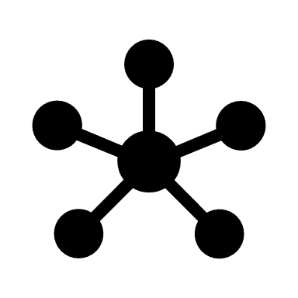




ML Model:
IBM Watson Cognitive Machine Learning
Model
Building
(SVC Algo)
Training Code
Trained Model
Deployed
Model
Production
Labeled data
(csv file)
Web App

Slide 13
Development(Cont.):
UI(User Interface) Layer:
In UI Layer is the User accessing layer where an user can access all his devices , prompt messages to controller devices like motor and irrigate the plant/crops.
Visualize the data analysis and prediction. And advises user to take action/irrigate accordingly.
This is layer is directly connected to Business layer as any operation performed in UI would carry out by logic layer for triggering functions to validation.
UI layer contains Dashboard – it would visualize the current temp, moisture and humid of the soil.
Then Prediction UI which would ask user to perform task with prediction for Smart irrigation
Lastly motor controller unit , which would enable user to operate the motor through UI.

Slide 14
Conclusion:
IOT will surely be a boon to agriculture with the proposed model. A Smart Irrigation System which will definitely be smart in real time for problem solving skills.
The hardware model is known as things and getting those things in the cloud serves the whole system as Internet of Things.
The implementation of machine learning as predictive model will surely prove more beneficial in agricultural sector so as to take proper measures before.

Slide 15
Q & A
Thank You!!

